Slide 1







Testing tool for weak application inputs
Juan E. Murcia, Rodrigo Castillo and David F. Martínez
MACC
U Rosario
juane.murcia@urosario.edu.co
rodrigo.castillo@urosario.edu.co
davidfel.martinez@urosario.edu.co
@MACC_URosario
@MACC.URosario
macc_ur
Notes:
Una imagen más bonita ocn etsrellas…

Slide 2

Agenda
Introduction
Project explanation

Slide 3

Introduction
Web application’s security is a crucial topic nowadays, since having internet access is more and more common around the world. However, several applications deployed still have now or even old vulnerabilities that people can exploit to take advantage from the application. One of the most common vulnerability is injection payloads into the input fields.

Slide 4
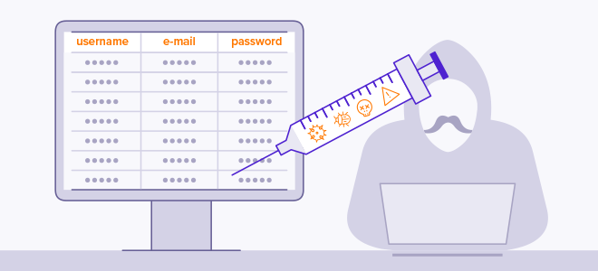

Problem Explanation
Due to the existence of such problem, we propose an application that tests several inputs found within a web application recursively, and then starts injecting payloads to check if some work, if it does the program will report which payload worked, and where it was used. We're going to parallelize the application in order to achieve efficiency.

Slide 5

Problem Explanation
Functional Requirements
The API should be able to
Connect to a given URL
Obtain all hyper references according to recursion level
Detect and store inputs addresses
Load a payload database to text
Try different attack vectors over the detected input fields
Report successful attacks

Slide 6
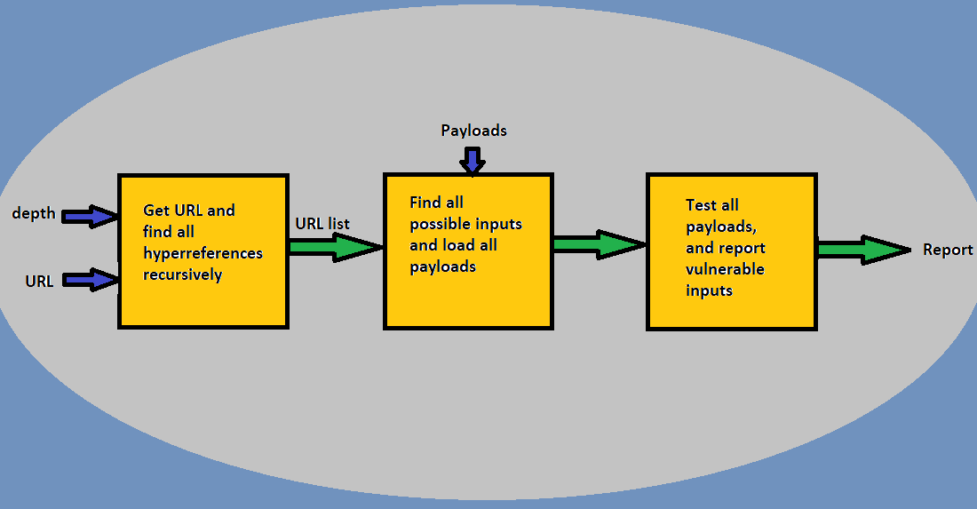
Problem Explanation
Projects Architecture

Slide 7
Problem Explanation
Sample of attack vectors
XSS
<script\x20type="text/javascript">javascript:alert(1);</script>
"`'><script>\x09javascript:alert(1)</script>
<img src\x09=x onerror="javascript:alert(1)">
<script /*%00*/>/*%00*/alert(1)/*%00*/</script /*%00*/
<math><a xlink:href="//jsfiddle.net/t846h/">click
SQL Injection
XXE Injection

Slide 8
THANKS!
Juan E. Murcia, Rodrigo Castillo and David F. Martínez
MACC
U Rosario
juane.murcia@urosario.edu.co
rodrigo.castillo@urosario.edu.co
davidfel.martinez@urosario.edu.co
@MACC_URosario
@MACC.URosario
macc_ur
Notes:
Una imagen más bonita ocn etsrellas…

